Slide 1


Analog Transmission

Slide 2



5-2 ANALOG AND DIGITAL
Analog-to-analog conversion is the representation of:
Analog information by an analog signal.

Slide 3
5-2 ANALOG AND DIGITAL
Need to modulate an analog signal; it is already analog?
Modulation is needed
If the medium is bandpass in nature
or
if only a bandpass channel is available to us.

Slide 4
Amplitude Modulation
Frequency Modulation
Phase Modulation

Slide 5
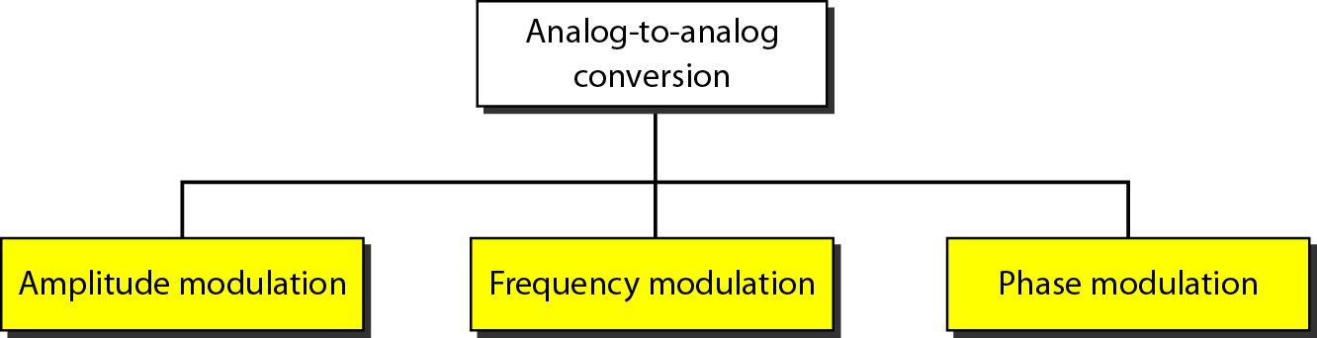
Figure 5.15 Types of analog-to-analog modulation

Slide 6
Amplitude Modulation
Carrier signal is modulated only in amplitude value.
Modulating signal is the envelope of the carrier.
Required bandwidth is 2B, where:
B is the bandwidth of the modulating signal

Slide 7
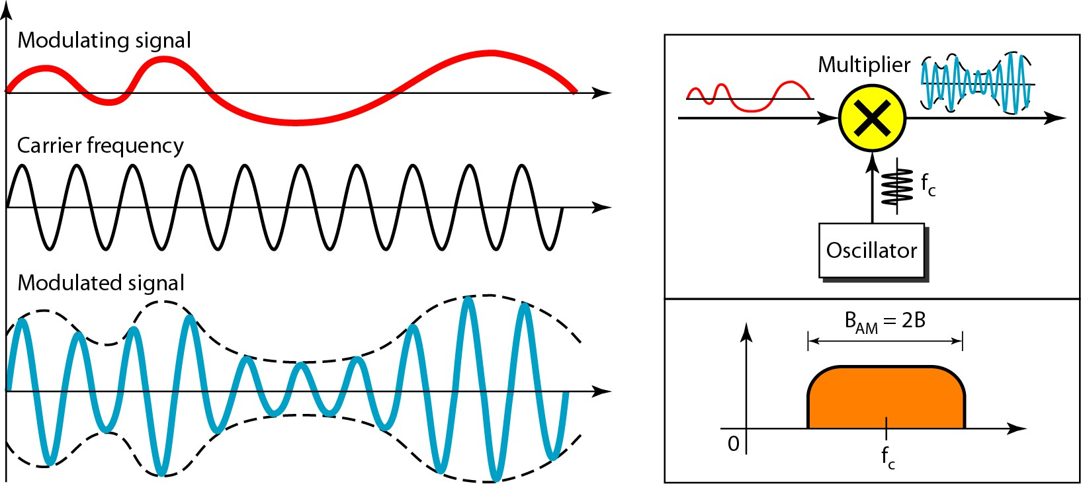
Figure 5.16 Amplitude modulation

Slide 8
Total bandwidth required for AM can be determined:
From the bandwidth of the audio signal: B_{AM} = 2B.

Slide 9
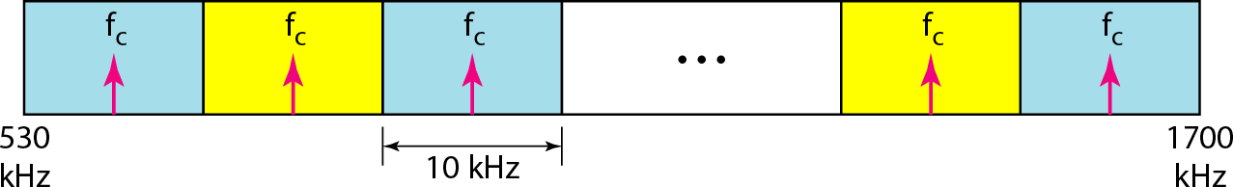
Figure 5.17 AM band allocation

Slide 10
Frequency Modulation
Modulating signal changes the freq.
f_{c} of the carrier signal
The bandwidth for FM is high
It is approx. 10x the signal frequency

Slide 11

Note
Bandwidth required for FM can be determined from:
Bandwidth
of the audio signal.
B_{FM} = 2(1 + β)B.
Where β is usually 4.

Slide 12
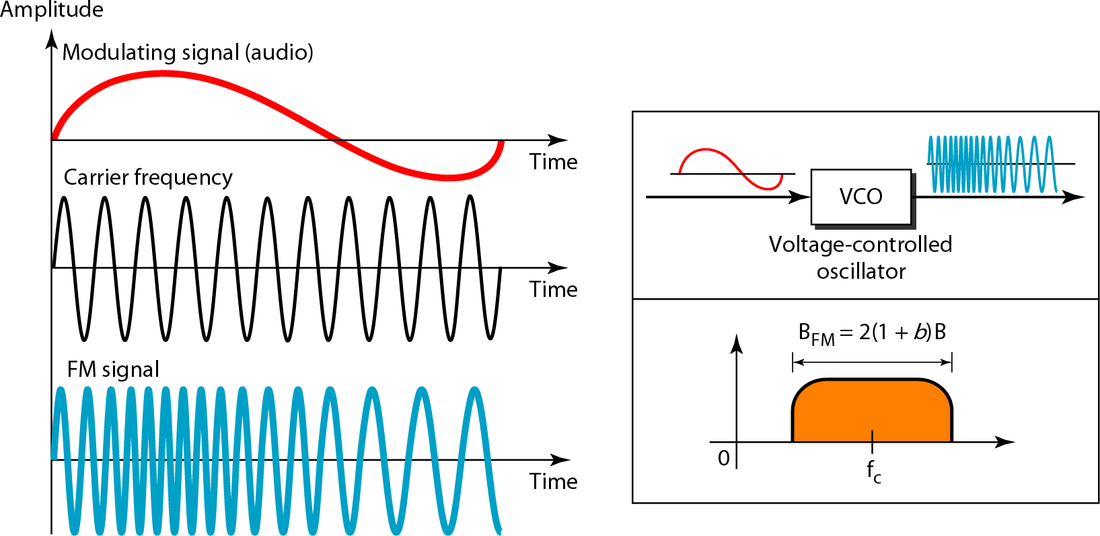
Figure 5.18 Frequency modulation

Slide 13
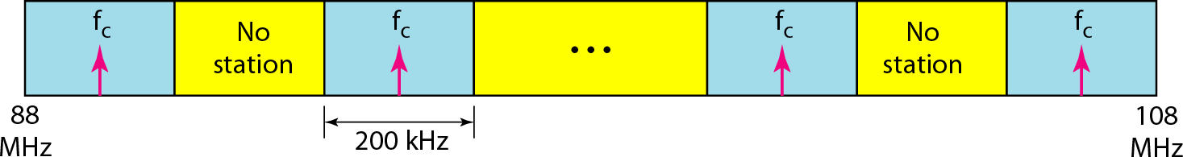
Figure 5.19 FM band allocation

Slide 14
Phase Modulation (PM)
Modulating signal only changes:
Phase of the carrier signal.
The phase change manifests itself as a frequency change.

Slide 15
Phase Modulation (PM)
But instantaneous frequency change is proportional to:
Derivative of the amplitude.
The bandwidth is higher than for AM.

Slide 16
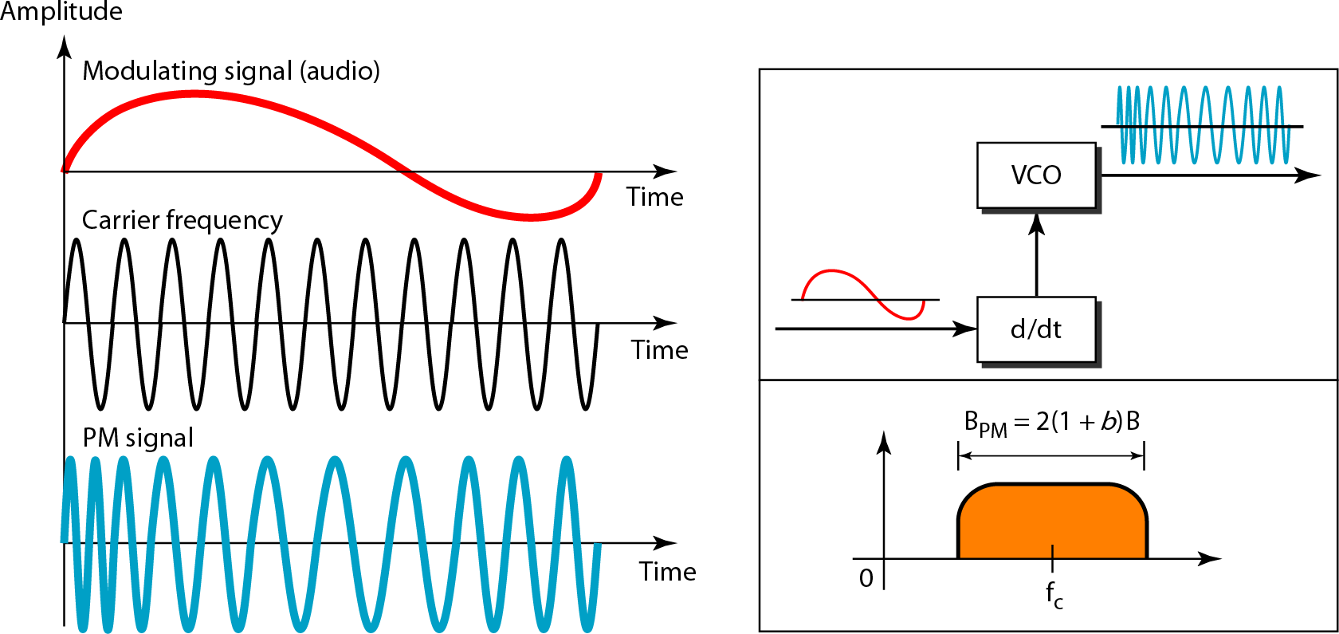
Figure 5.20 Phase modulation

Slide 17
Bandwidth required for PM can be determined:
From the bandwidth and maximum amplitude of the modulating signal:
B_{PM} = 2(1 + β)B.
Where β = 2 most often.

Slide 18
😜 Q1: I’m the drama queen of signals—
I only change amplitude and still hog the spotlight.
Who am I?
A. Frequency Modulation
B. Amplitude Modulation
C. Phase Modulation
Notes:
Answer: B. Amplitude Modulation
Justification:
AM modifies only the amplitude of the carrier signal. It’s dramatic in its envelope style and uses bandwidth = 2B.

Slide 19
😜 Q1: I’m the drama queen of signals—
I only change amplitude and still hog the spotlight.
Who am I?
A. Frequency Modulation
B. Amplitude Modulation
C. Phase Modulation
Notes:
Answer: B. Amplitude Modulation
Justification:
AM modifies only the amplitude of the carrier signal. It’s dramatic in its envelope style and uses bandwidth = 2B.

